Slide 1
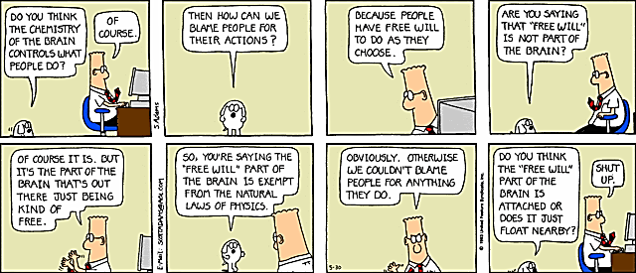
Freedom and Responsibility
PH1102E/GEK1067, Lecture 2

Slide 2
Today’s Plan
Moral responsibility and freedom of will
Free-will under attack
Free-will defended…unsuccessfully
Responsibility without freedom?

Slide 3
Moral responsibility and freedom of will

Slide 4
Moral Responsibility
To say that someone is morally responsible for doing X is to say that he or she deserves praise or blame for doing X.
So when we talk about “moral responsibility,” we are just talking about praiseworthy and blameworthy behavior.
(Note that most behavior is neither blameworthy nor praiseworthy: brushing your teeth, tying your shoelaces, riding the bus, etc.)

Slide 5
Agent | Outcome | Was the agent morally responsible for the outcome?
Hungry Bird | Fruit lost | No
Thieving Student | Fruit lost | Yes
Sweaty Franz | Jewish family captured | No
Treacherous Franz | Jewish family captured | Yes
Heroic Swimmer | Little girl saved | Yes
Ball Bumper | Little girl saved | No
Fish Tosser | Little girl saved | No

Slide 6
Agent | Outcome | Was the agent morally responsible for the outcome?
Hungry Bird | Fruit lost | No
Thieving Student | Fruit lost | Yes
Sweaty Franz | Jewish family captured | No
Treacherous Franz | Jewish family captured | Yes
Heroic Swimmer | Little girl saved | Yes
Ball Bumper | Little girl saved | No
Fish Tosser | Little girl saved | No

Slide 7
Agent | Outcome | Was the agent morally responsible for the outcome?
Hungry Bird | Fruit lost | No
Thieving Student | Fruit lost | Yes
Sweaty Franz | Jewish family captured | No
Treacherous Franz | Jewish family captured | Yes
Heroic Swimmer | Little girl saved | Yes
Ball Bumper | Little girl saved | No
Fish Tosser | Little girl saved | No

Slide 8
Agent | Outcome | Was the agent morally responsible for the outcome?
Hungry Bird | Fruit lost | No
Thieving Student | Fruit lost | Yes
Sweaty Franz | Jewish family captured | No
Treacherous Franz | Jewish family captured | Yes
Heroic Swimmer | Little girl saved | Yes
Ball Bumper | Little girl saved | No
Fish Tosser | Little girl saved | No

Slide 9
Agent | Outcome | Was the agent morally responsible for the outcome?
Hungry Bird | Fruit lost | No
Thieving Student | Fruit lost | Yes
Sweaty Franz | Jewish family captured | No
Treacherous Franz | Jewish family captured | Yes
Heroic Swimmer | Little girl saved | Yes
Ball Bumper | Little girl saved | No
Fish Tosser | Little girl saved | No

Slide 10
Agent | Outcome | Was the agent morally responsible for the outcome?
Hungry Bird | Fruit lost | No
Thieving Student | Fruit lost | Yes
Sweaty Franz | Jewish family captured | No
Treacherous Franz | Jewish family captured | Yes
Heroic Swimmer | Little girl saved | Yes
Ball Bumper | Little girl saved | No
Fish Tosser | Little girl saved | No

Slide 11
Agent | Outcome | Was the agent morally responsible for the outcome?
Hungry Bird | Fruit lost | No
Thieving Student | Fruit lost | Yes
Sweaty Franz | Jewish family captured | No
Treacherous Franz | Jewish family captured | Yes
Heroic Swimmer | Little girl saved | Yes
Ball Bumper | Little girl saved | No
Fish Tosser | Little girl saved | No

Slide 12
Agent | Outcome | Was the agent morally responsible for the outcome?
Hungry Bird | Fruit lost | No
Thieving Student | Fruit lost | Yes
Sweaty Franz | Jewish family captured | No
Treacherous Franz | Jewish family captured | Yes
Heroic Swimmer | Little girl saved | Yes
Ball Bumper | Little girl saved | No
Fish Tosser | Little girl saved | No

Slide 13
Agent | Outcome | Was the agent morally responsible for the outcome?
Hungry Bird | Fruit lost | No
Thieving Student | Fruit lost | Yes
Sweaty Franz | Jewish family captured | No
Treacherous Franz | Jewish family captured | Yes
Heroic Swimmer | Little girl saved | Yes
Ball Bumper | Little girl saved | No
Fish Tosser | Little girl saved | No

Slide 14
Agent | Outcome | Was the agent morally responsible for the outcome?
Hungry Bird | Fruit lost | No
Thieving Student | Fruit lost | Yes
Sweaty Franz | Jewish family captured | No
Treacherous Franz | Jewish family captured | Yes
Heroic Swimmer | Little girl saved | Yes
Ball Bumper | Little girl saved | No
Fish Tosser | Little girl saved | No
Suggestion: the difference between the morally responsible agents and the other agents is that only the morally responsible agents brought about the outcome of their own free will.

Slide 15
Free-will under attack

Slide 16
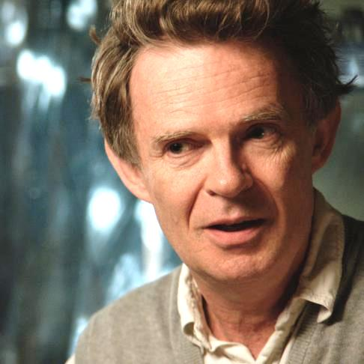
Galen Strawson (1952- )

Slide 17
You act freely only if your behavior is not predetermined by factors beyond your control.
But in all of these cases, the agents’ behavior is predetermined by factors beyond their control (genes, etc.).
So in none of the cases is the agent morally responsible for the outcome!
Galen Strawson (1952- )

Slide 18
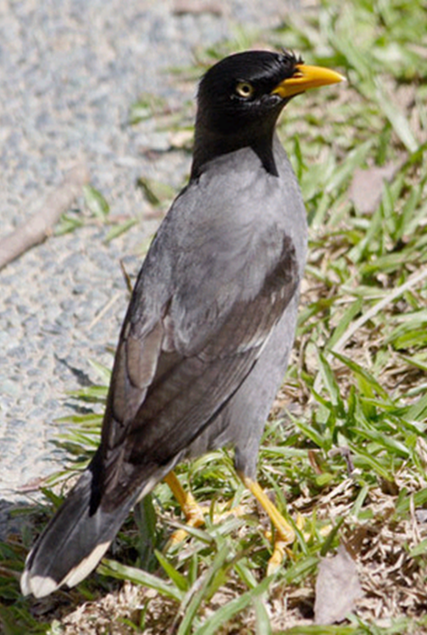

Self & Nature
NTU

Slide 19
The student’s decision to eat your fruit was an inevitable consequence of events over which the student never had any control (genes, early environment, etc).

Slide 20
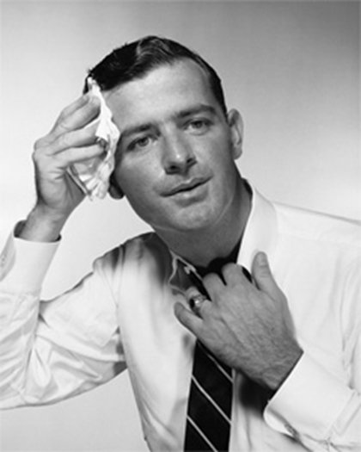
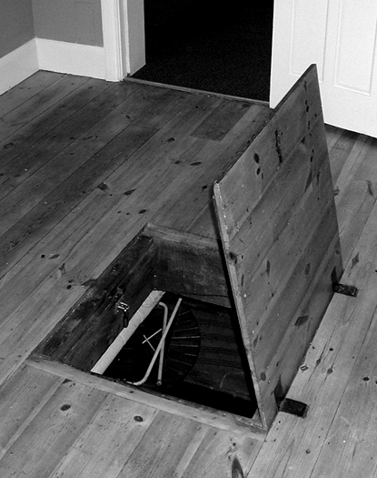
Self & Nature

Slide 21
Treacherous Franz’s decision to betray the Jewish family was an inevitable consequence of events over which Franz never had any control (genes, early environment, etc).

Slide 22
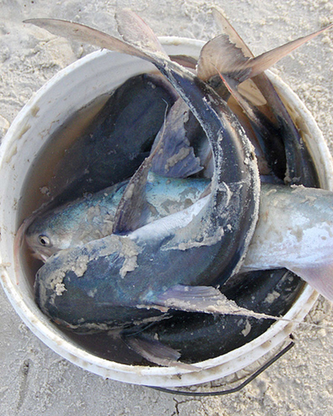
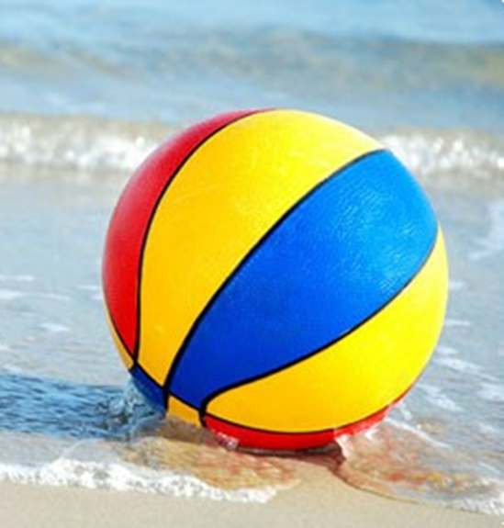
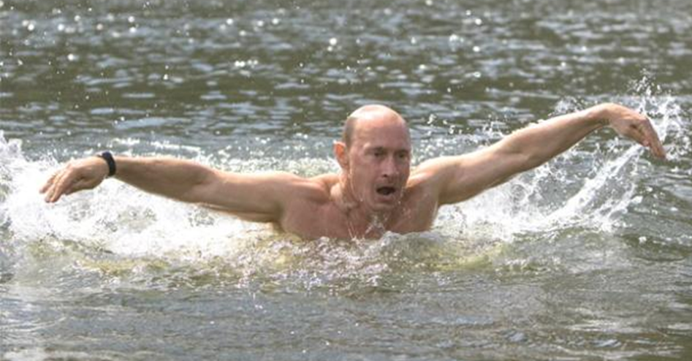
Self & Nature

Slide 23
My decision to save the little girl was an inevitable consequence of events over which I never had any control (genes, early environment, etc).

Slide 24
Free-will defended… unsuccessfully

Slide 25
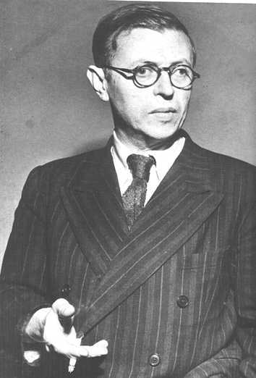
Jean-Paul Sartre (1905-1980)

Slide 26
What Strawson fails to recognize is that a human being, unlike a bird or the wind, has a capacity for ultimate self-determination.
I am not merely a product of the Big Bang and the laws of physics: when I form a good or bad intention, the formation of that intention in me is like a “Little Bang,” uncaused by anything that came before.
Jean-Paul Sartre (1905-1980)

Slide 27
What Strawson fails to recognize is that a human being, unlike a bird or the wind, has a capacity for ultimate self-determination.
My actions are not mere links in a chain extending back to the Big Bang. When I make a conscious decision to do something good or bad, that decision is like a “Little Bang,” uncaused by anything that came before.
Jean-Paul Sartre (1905-1980)

Slide 28
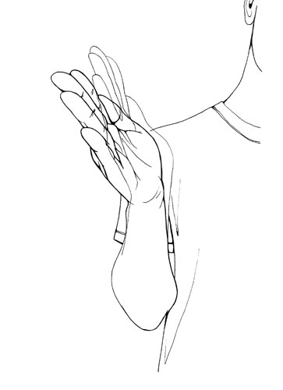
Uncaused “original-with-me” decision
Action for which I am morally responsible

Slide 29
OK Sartre, let’s suppose you’re right. So when the student ate your fruit, his decision to do so was not just a result of his genes, upbringing, etc. Instead, the decision was an event that originated purely within the student, uncaused by any prior event.
But if an event occurs without any cause, just out of the blue, then it is a random event.

Slide 30

So what?

Slide 31
Well, a random event is an event over which no one has control (otherwise, the event wouldn’t be random).

Slide 32
Well, a random event is an event over which no one has control (otherwise, the event wouldn’t be random).
So, if the student’s decision to eat your fruit was a random event, then the student had no more control over the decision than if the decision had occurred in him as a result of events that took place before he was born.

Slide 33
Uncaused decision

Slide 34
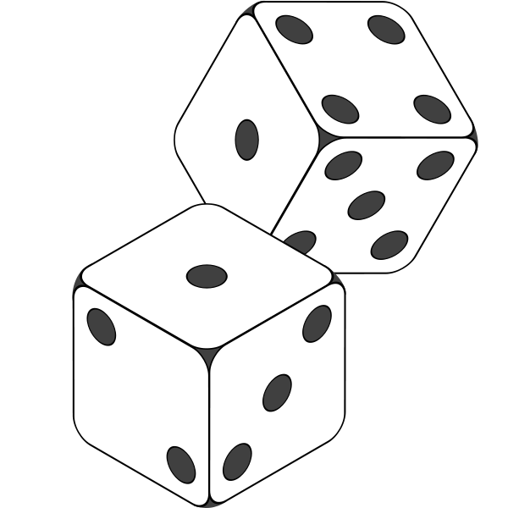

Slide 35
behavior for which I am not morally responsible

Slide 36
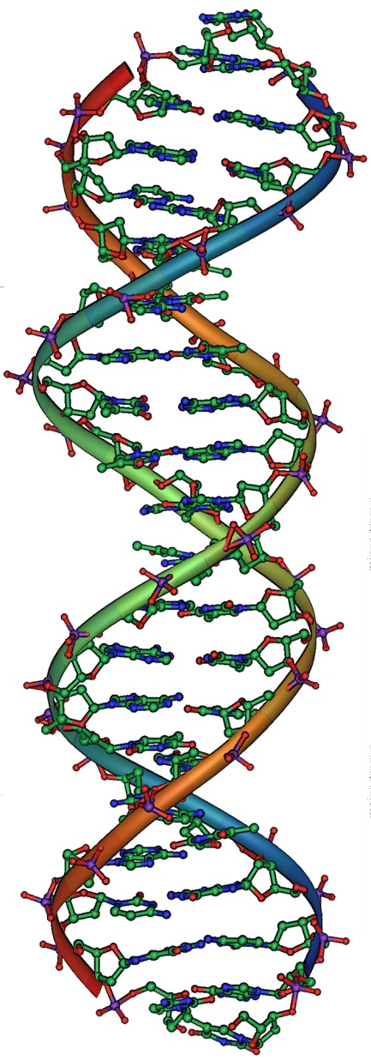
behavior for which I am not morally responsible

Slide 37
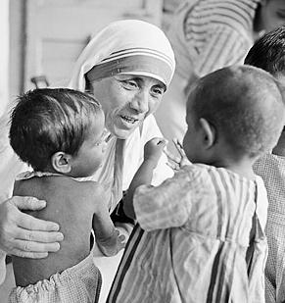
behavior for which I am not morally responsible

Slide 38
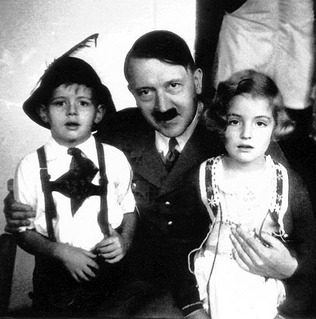
behavior for which I am not morally responsible

Slide 39
So, whether the student’s decision to eat your fruit was caused or uncaused, the student did not act of his own free will in eating your fruit.
So he does not deserve to be blamed for eating your fruit.
And what goes for the student goes for everyone else: no one deserves to be praised or blamed for anything.
There is no such thing as moral responsibility.

Slide 40
Responsibility without freedom

Slide 41
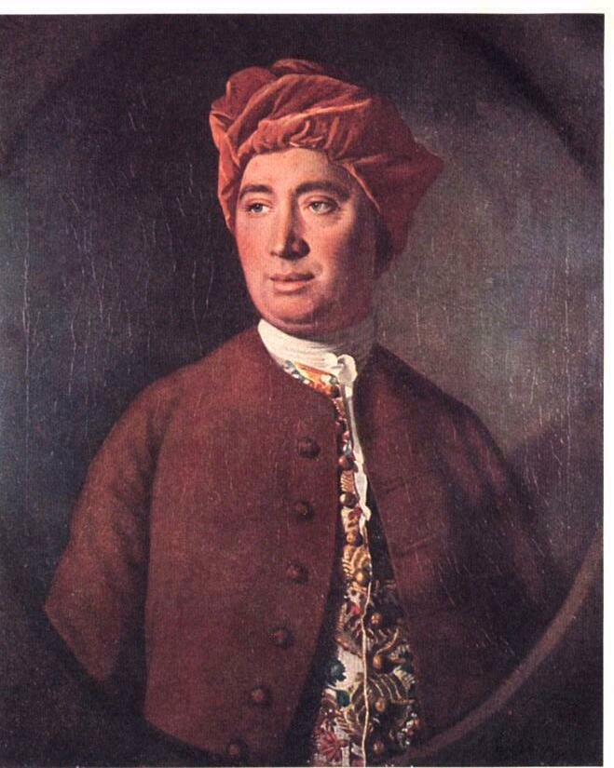
David Hume (1711-1776)

Slide 42
An agent is morally responsible (blameworthy or praiseworthy) for doing some harm or good so long as the agent causes the harm or benefit intentionally.
David Hume (1711-1776)

Slide 43
Agent | Intended the harmful or beneficial outcome? | Morally responsible for the harmful or beneficial outcome?
Treacherous Franz | Yes | Yes
Sweaty Franz | No | No
Heroic Swimmer | Yes | Yes
Ball Bumper | No | No
Fish Tosser | No | No
Hungry Bird | No | No
Thieving Student | Maybe not! | Yes

Slide 44
Agent | Intended the harmful or beneficial outcome? | Morally responsible for the harmful or beneficial outcome?
Treacherous Franz | Yes | Yes
Sweaty Franz | No | No
Heroic Swimmer | Yes | Yes
Ball Bumper | No | No
Fish Tosser | No | No
Hungry Bird | No | No
Thieving Student | Maybe not! | Yes

Slide 45
Agent | Intended the harmful or beneficial outcome? | Morally responsible for the harmful or beneficial outcome?
Treacherous Franz | Yes | Yes
Sweaty Franz | No | No
Heroic Swimmer | Yes | Yes
Ball Bumper | No | No
Fish Tosser | No | No
Hungry Bird | No | No
Thieving Student | Maybe not! | Yes

Slide 46
Agent | Intended the harmful or beneficial outcome? | Morally responsible for the harmful or beneficial outcome?
Treacherous Franz | Yes | Yes
Sweaty Franz | No | No
Heroic Swimmer | Yes | Yes
Ball Bumper | No | No
Fish Tosser | No | No
Hungry Bird | No | No
Thieving Student | Maybe not! | Yes

Slide 47
Agent | Intended the harmful or beneficial outcome? | Morally responsible for the harmful or beneficial outcome?
Treacherous Franz | Yes | Yes
Sweaty Franz | No | No
Heroic Swimmer | Yes | Yes
Ball Bumper | No | No
Fish Tosser | No | No
Hungry Bird | No | No
Thieving Student | Maybe not! | Yes

Slide 48
Agent | Intended the harmful or beneficial outcome? | Morally responsible for the harmful or beneficial outcome?
Treacherous Franz | Yes | Yes
Sweaty Franz | No | No
Heroic Swimmer | Yes | Yes
Ball Bumper | No | No
Fish Tosser | No | No
Hungry Bird | No | No
Thieving Student | Maybe not! | Yes

Slide 49
Agent | Intended the harmful or beneficial outcome? | Morally responsible for the harmful or beneficial outcome?
Treacherous Franz | Yes | Yes
Sweaty Franz | No | No
Heroic Swimmer | Yes | Yes
Ball Bumper | No | No
Fish Tosser | No | No
Hungry Bird | No | No
Thieving Student | Maybe not! | Yes

Slide 50
Agent | Intended the harmful or beneficial outcome? | Morally responsible for the harmful or beneficial outcome?
Treacherous Franz | Yes | Yes
Sweaty Franz | No | No
Heroic Swimmer | Yes | Yes
Ball Bumper | No | No
Fish Tosser | No | No
Hungry Bird | No | No
Thieving Student | Maybe not! | Yes

Slide 51
Agent | Intended the harmful or beneficial outcome? | Morally responsible for the harmful or beneficial outcome?
Treacherous Franz | Yes | Yes
Sweaty Franz | No | No
Heroic Swimmer | Yes | Yes
Ball Bumper | No | No
Fish Tosser | No | No
Hungry Bird | No | No
Thieving Student | Maybe not! | Yes

Slide 52
Agent | Intended the harmful or beneficial outcome? | Morally responsible for the harmful or beneficial outcome?
Treacherous Franz | Yes | Yes
Sweaty Franz | No | No
Heroic Swimmer | Yes | Yes
Ball Bumper | No | No
Fish Tosser | No | No
Hungry Bird | No | No
Thieving Student | Maybe not! | Yes

Slide 53
Agent | Intended the harmful or beneficial outcome? | Morally responsible for the harmful or beneficial outcome?
Treacherous Franz | Yes | Yes
Sweaty Franz | No | No
Heroic Swimmer | Yes | Yes
Ball Bumper | No | No
Fish Tosser | No | No
Hungry Bird | No | No
Thieving Student | Maybe not! | Yes

Slide 54
Agent | Intended the harmful or beneficial outcome? | Morally responsible for the harmful or beneficial outcome?
Treacherous Franz | Yes | Yes
Sweaty Franz | No | No
Heroic Swimmer | Yes | Yes
Ball Bumper | No | No
Fish Tosser | No | No
Hungry Bird | No | No
Thieving Student | Maybe not! | Yes

Slide 55
Agent | Intended the harmful or beneficial outcome? | Morally responsible for the harmful or beneficial outcome?
Treacherous Franz | Yes | Yes
Sweaty Franz | No | No
Heroic Swimmer | Yes | Yes
Ball Bumper | No | No
Fish Tosser | No | No
Hungry Bird | Yes? | No
Thieving Student | Maybe not! | Yes

Slide 56
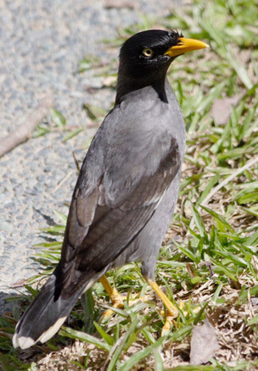

Slide 57
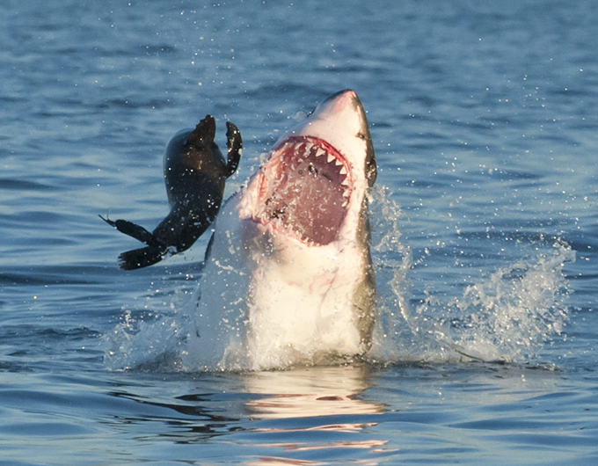

Slide 58
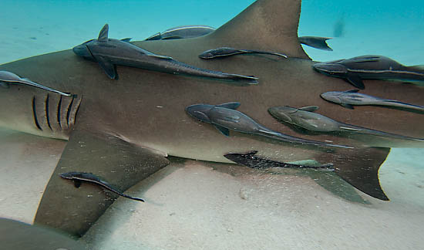

Slide 59
Agent | Intended the harmful or beneficial outcome? | Morally responsible for the harmful or beneficial outcome?
Treacherous Franz | Yes | Yes
Sweaty Franz | No | No
Heroic Swimmer | Yes | Yes
Ball Bumper | No | No
Fish Tosser | No | No
Hungry Bird | Yes? | No
Thieving Student | Maybe not! | Yes

Slide 60
Agent | Intended the harmful or beneficial outcome? | Morally responsible for the harmful or beneficial outcome?
Treacherous Franz | Yes | Yes
Sweaty Franz | No | No
Heroic Swimmer | Yes | Yes
Ball Bumper | No | No
Fish Tosser | No | No
Hungry Bird | No | No
Thieving Student | Maybe not! | Yes

Slide 61
Agent | Intended the harmful or beneficial outcome? | Morally responsible for the harmful or beneficial outcome?
Treacherous Franz | Yes | Yes
Sweaty Franz | No | No
Heroic Swimmer | Yes | Yes
Ball Bumper | No | No
Fish Tosser | No | No
Hungry Bird | No | No
Thieving Student |  | Yes

Slide 62
Agent | Intended the harmful or beneficial outcome? | Morally responsible for the harmful or beneficial outcome?
Treacherous Franz | Yes | Yes
Sweaty Franz | No | No
Heroic Swimmer | Yes | Yes
Ball Bumper | No | No
Fish Tosser | No | No
Hungry Bird | No | No
Thieving Student | Maybe not! | Yes

Slide 63
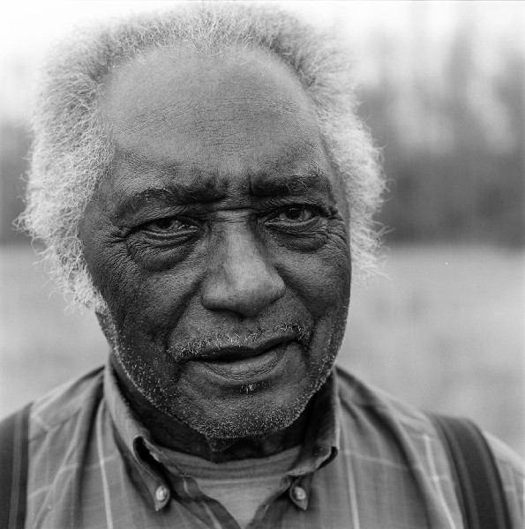
R.L. Burnside (1926-2005)

Slide 64
“I didn't mean to kill nobody. I just meant to shoot the sonofabitch in the head. Him dying was between him and the Lord.”
R.L. Burnside (1926-2005)

Slide 65
Agent | Intended the harmful or beneficial outcome? | Morally responsible for the harmful or beneficial outcome?
Treacherous Franz | Yes | Yes
Sweaty Franz | No | No
Heroic Swimmer | Yes | Yes
Ball Bumper | No | No
Fish Tosser | No | No
Hungry Bird | No | No
Thieving Student | Maybe not! | Yes

Slide 66
Hume’s claim is that intentionally doing some good or harm is sufficient for moral responsibility.
Hume is not claiming that intentionally doing some good or harm is necessary for moral responsibility.
He’s just saying that IF you have a case of intentional benefit or harm, THEN that is a case of moral responsibility.

Slide 67
Agent | Intended the harmful or beneficial outcome? | Morally responsible for the harmful or beneficial outcome?
Treacherous Franz | Yes | Yes
Sweaty Franz | No | No
Heroic Swimmer | Yes | Yes
Ball Bumper | No | No
Fish Tosser | No | No
Hungry Bird | No | No
Thieving Student | ? | Yes

Slide 68
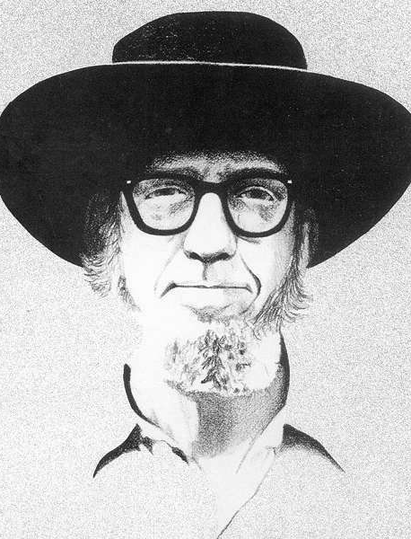
Richard Taylor (1919-2003)

Slide 69
Just because you bring about some harm intentionally doesn’t mean that you are morally responsible for causing that harm.
You are morally responsible only if your action was not pre-determined by forces or factors that were beyond your control.
Richard Taylor (1919-2003)

Slide 70
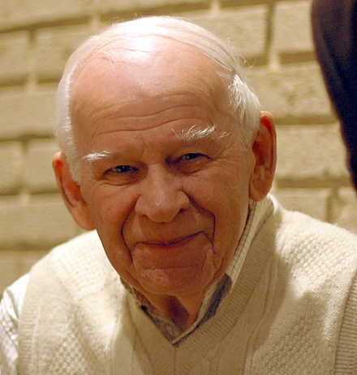
Mr. Smith

Slide 71
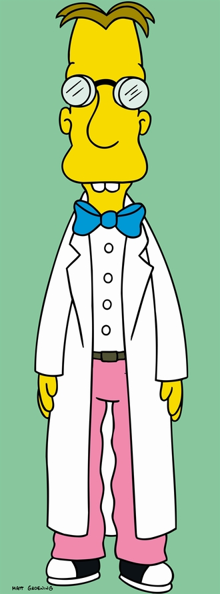
Mr. Smith
Dr. Frink

Slide 72
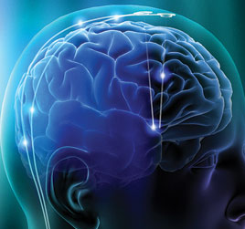
Mr. Smith
Smith’s Brain
Dr. Frink

Slide 73

Mr. Smith
Smith’s Brain
Dr. Frink
Murder!

Slide 74
Mr. Smith
Smith’s Brain
Dr. Frink
Murder!

Slide 75
An argument against Hume
Mr. Smith stabbed his wife with the intention of killing her.
But according to Hume, a person is morally responsible for any harm that he brings about intentionally.
So, Hume must say that Mr. Smith is morally responsible for murdering his wife.
But surely Mr. Smith is not morally responsible for this!
So Hume must be wrong.

Slide 76
Not so fast!
Yes, someone is morally responsible for murdering Granny.
But that someone is not Gramps!
By scrambling Gramps’ brain so much, Frink has destroyed Gramps and replaced him with another person. It is this new (and evil) person who is morally responsible for Granny’s death.

Slide 77
Not so fast!
Yes, someone was morally responsible for murdering Mrs. Smith.
But that someone was not Mr. Smith!
By scrambling Gramps’ brain so much, Frink has destroyed Gramps and replaced him with another person. It is this new (and evil) person who is morally responsible for Granny’s death.

Slide 79
By scrambling Mr. Smiths’ brain so much, Frink destroyed Smith and replaced him with another person. It was this new (and evil) person who is to blame for Mrs. Smith’s death.
And he was to blame precisely because he (the new, evil man, not nice old Mr. Smith) caused her death intentionally.

Slide 80
Does Hume’s diagnosis of the Smith scenario hold water?
Tune in on Week 10 to find out!

Slide 81
Does Hume’s diagnosis of the Smith scenario hold water?
Tune in on Week 10 to find out!

Slide 82
Weekly Assignment #1
In the reading for next week, Roger Crisp defends the view that “pleasure is all that matters.” Summarize the main points of Crisp’s article as well as you can.
Limit: 200 words.
Upload by 8 p.m. Thursday, 28 August 2014.

